Slide 1
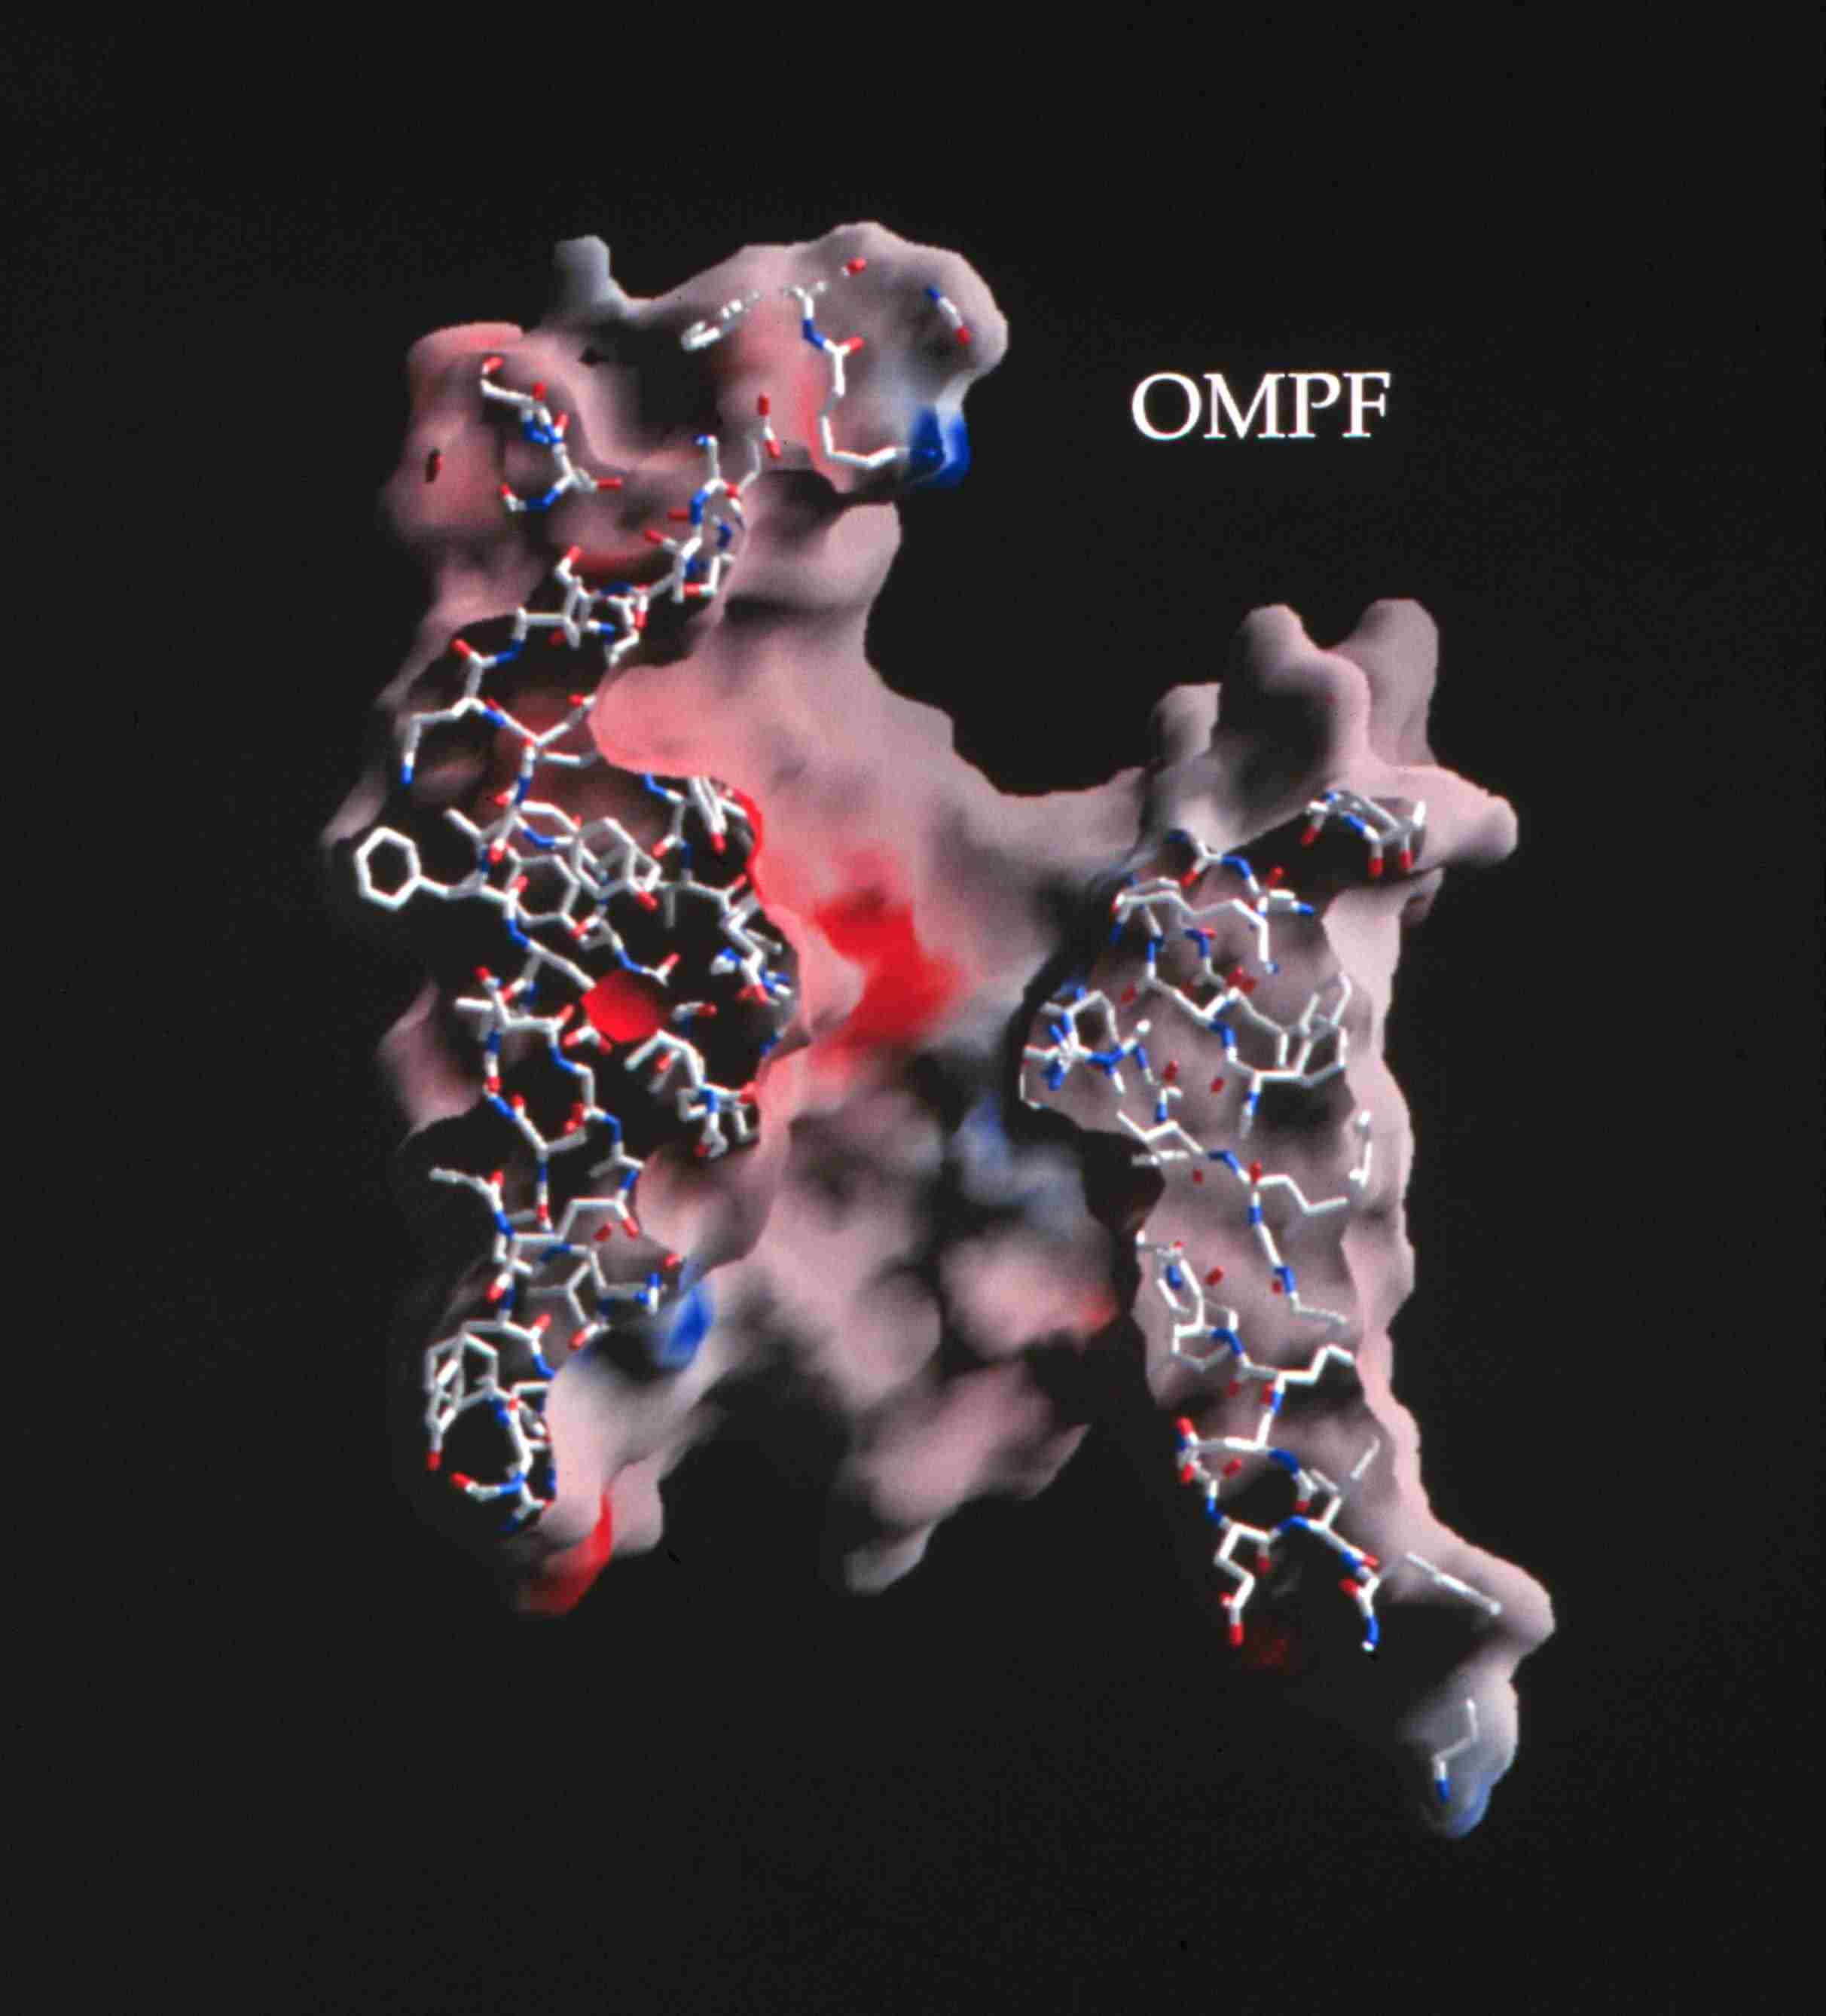
Ion Channels are the Valves of Cells Ion Channels are Devices* that Control Biological Function
Selectivity
Different Ions carry Different Signals
Ions in Water are the
Liquid of Life
Hard Spheres
Na⁺
Chemical Bonds are lines
Surface is Electrical Potential
Red is negative (acid)
Blue is positive (basic)
Ca⁺⁺
K⁺
+
Figure of ompF porin by Raimund Dutzler
0.7 nm = Channel Diameter
~30 Å
3 Å
*Devices as defined in engineering , with inputs and outputs, and power supplies.
Notes:
MD scales are very different

Slide 2
Ion Channels are a good Test Case
Simple Physics (Electrodiffusion)
Single Structure (once open)
Simple Theory is Possible and Reasonably Robust because Channels are Devices
with well defined Inputs, Outputs and Power Supplies
Channels are also Biologically Very Important

Slide 3
Natural nano-valves* for atomic control of biological function
Ion Channels are Biological Devices
Ion channels coordinate contraction of cardiac muscle, allowing the heart to function as a pump
Ion channels coordinate contraction in skeletal muscle
Ion channels control all electrical activity in cells Ion channels produce signals of the nervous system
Ion channels are involved in secretion and absorption in all cells: kidney, intestine, liver, adrenal glands, etc.
Ion channels are involved in thousands of diseases and many drugs act on channels
Ion channels are proteins whose genes (blueprints) can be manipulated by molecular genetics
Ion channels have structures shown by x-ray crystallography in favorable cases
K⁺
~30 Å
*nearly pico-valves: diameter is 400 – 900 picometers
Notes:
Ion channels are a class of Proteins that reside in the cell membrane of all biological cells. Each channel protein consists of a chain of amino acids folded in such a way that it forms a nanoscopic water-filled tunnel through which ions can flow to cross the otherwise impermeable membrane.
Every ion channel carries a strong and steeply varying distribution of permanent charge, which depends on the particular combination of channel and prevalent physiological conditions. This permanent charge has an important role in determining the current-voltage characteristics of the open channel.
Many channels are designed by nature to selectively transmit or block a particular ion species. This allows only one type of ion to cross the membrane even though other ions may be present in much higher concentrations. Many channels can also open and close by mechanical or other means, switching on and off like electronic devices.
From a physiological point of view ion channels are essential for maintaining the correct internal ion composition necessary for cell survival and function. They directly control electrical signaling in the nervous system, muscle contraction, and the delivery of many clinical drugs. Malfunctioning channels cause or are associated with many diseases.
From a device point of view, ion channels can be thought of as elements in an electrical circuit, behaving like resistors, diodes or batteries depending on the specific channel and environmental factors. By replacing or deleting one or more of the amino acids many channels can be mutated, altering the charge distribution along the channel. Designing and engineering channels with specific conductances and selectivities, and incorporating them into bio-devices, is a real possibility.

Slide 4

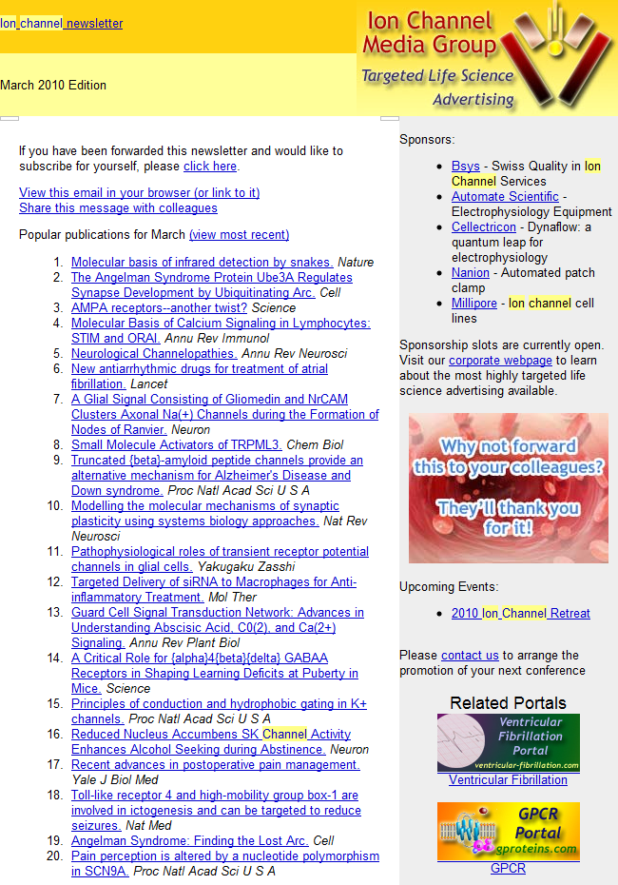
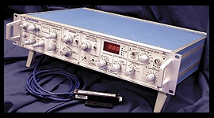
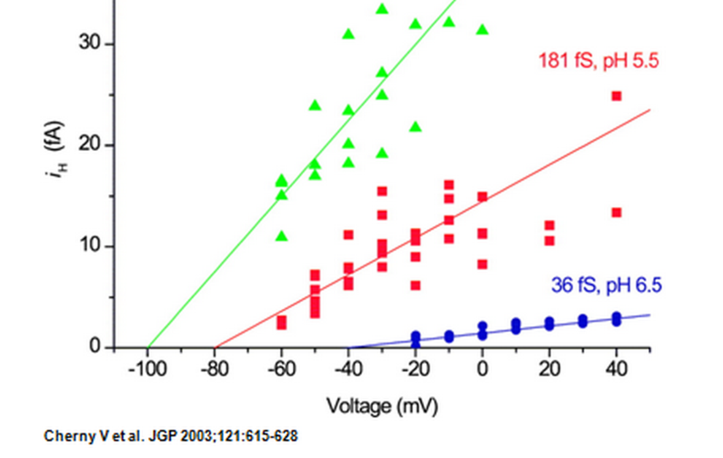
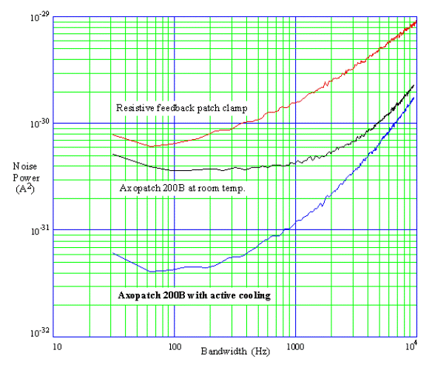
Thousands of Molecular Biologists Study Channels every day, One protein molecule at a time This number is not an exaggeration. We have sold >10,000 AxoPatch amplifiers
Ion Channel Monthly
AxoPatch 200B
Femto-amps
(10⁻¹⁵ A)

Slide 5
Channel Structure Does Not Change
once the channel is open
Current vs. time
Amplitude vs. Duration
Open
Closed
Open Amplitude, pA
5 pA
100 ms
Open Duration /ms
Lowpass Filter = 1 kHz Sample Rate = 20 kHz
Typical Raw Single Channel Records
Ca²⁺ Release Channel of Inositol Trisphosphate Receptor: slide and data from Josefina Ramos-Franco. Thanks!

Slide 6
Channels are Selective Different Ions Carry Different Signals through Different Channels
ompF porin
Ca⁺⁺
Na⁺
K⁺
3 Å
+
0.7 nm = Channel Diameter
Diameter matters
In ideal solutions K⁺ = Na⁺
~30 Å
Flow time scale is 0.1 msec to 1 min
Figure of ompF porin by Raimund Dutzler

Slide 7
Channels are Selective because Diameter Matters
Ions are NOT Ideal
Potassium K⁺ = Na⁺ Sodium
/
K⁺
Na⁺
3 Å
Ideal Ions are Identical
if they have the same charge
In ideal solutions K⁺ = Na⁺

Slide 8
Channels are Selective
Different Types of Channels
use
Different Types of Ions for
Different Information

Slide 9
Goal:
Understand Selectivity
well enough to Fit Large Amounts of Data
from many solutions and concentrations and to
Make a Calcium Channel
Atomic Scale
atomic × 10¹⁰ = MACRO
MACRO Scale

Slide 10
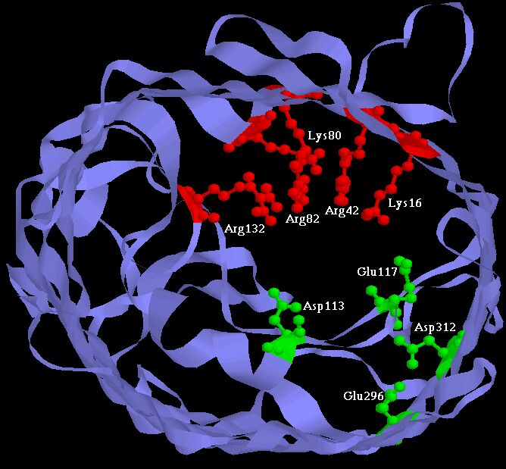
Experiments have built Two Synthetic Calcium Channels
Atomic Scale
Mutants of ompF Porin
Designed by Theory
Glutathione derivatives
MUTANT ─ Compound
Calcium selective
Unselective
Wild Type
As density of permanent charge increases, channel becomes calcium selective E_{rev} → E_{Ca} in 0.1M 1.0 M CaCl₂
Macro Scale
||
built by Henk Miedema, Wim Meijberg of BioMade Corp.,Groningen, Netherlands
Miedema et al, Biophys J 87: 3137–3147 (2004)

Slide 11
Comparison with Experiments shows
Potassium K⁺ Sodium Na⁺
Working Hypothesis
Biological Adaptation is
Crowded Ions and Side Chains

Slide 12
Physical basis of function
Active Sites of Proteins are Very Charged
7 charges ~ 20 M net charge
= 1.2×10²² cm⁻³
liquid Water is 55 M solid NaCl is 37 M
OmpF Porin
Ions are Crowded
Hard Spheres
Na⁺
+
+
+
+
+
K⁺
Ca²⁺
Na⁺
-
-
-
K⁺
-
Induced Fit of Side Chains
4 Å
Selectivity Filters and Gates of Ion Channels
are
Active Sites
Figure adapted from Tilman Schirmer

Slide 13
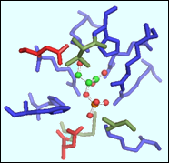
Ionizable Residues Density = 22 M
 |  | #AA | MS_A^3 | CD_MS+ | CD_MS- | CD_MSt
EC1:Oxidoreductases | Average | 47.2 | 1,664.74 | 7.58 | 2.82 | 10.41
 | Median | 45.0 | 1,445.26 | 6.12 | 2.49 | 8.70
EC2:Transferases | Average | 33.8 | 990.42 | 13.20 | 6.63 | 19.83
 | Median | 32.0 | 842.43 | 8.18 | 6.71 | 14.91
EC3:Hydrolases | Average | 24.3 | 682.88 | 13.14 | 13.48 | 26.62
 | Median | 20.0 | 404.48 | 11.59 | 12.78 | 23.64
EC4:Lyases | Average | 38.2 | 1,301.89 | 13.16 | 6.60 | 19.76
 | Median | 28.0 | 822.73 | 10.81 | 4.88 | 16.56
EC5:Isomerases | Average | 31.6 | 1,027.15 | 24.03 | 11.30 | 35.33
 | Median | 34.0 | 989.98 | 9.05 | 7.76 | 16.82
EC6:Ligases | Average | 44.4 | 1,310.03 | 9.25 | 9.93 | 19.18
 | Median | 49.0 | 1,637.98 | 8.32 | 7.95 | 17.89
 |  | #AA | MS_A^3 | CD_MS+ | CD_MS- | CD_MSt
Total n= 150 | Average | 36.6 | 1,162.85 | 13.39 | 8.46 | 21.86
 | Median | 33.0 | 916.21 | 8.69 | 7.23 | 16.69
EC#: Enzyme Commission Number based on chemical reaction catalyzed
#AA: Number of residues in the functional pocket
MS_A^3: Molecular Surface Area of the Functional Pocket (Units Angstrom^3)
CD_MS+: Base Density (probably positive)
CD_MS-: Acid Density (probably negative)
CD_MSt: Total Ionizable density
Jimenez-Morales,
Liang,
Eisenberg

Slide 14
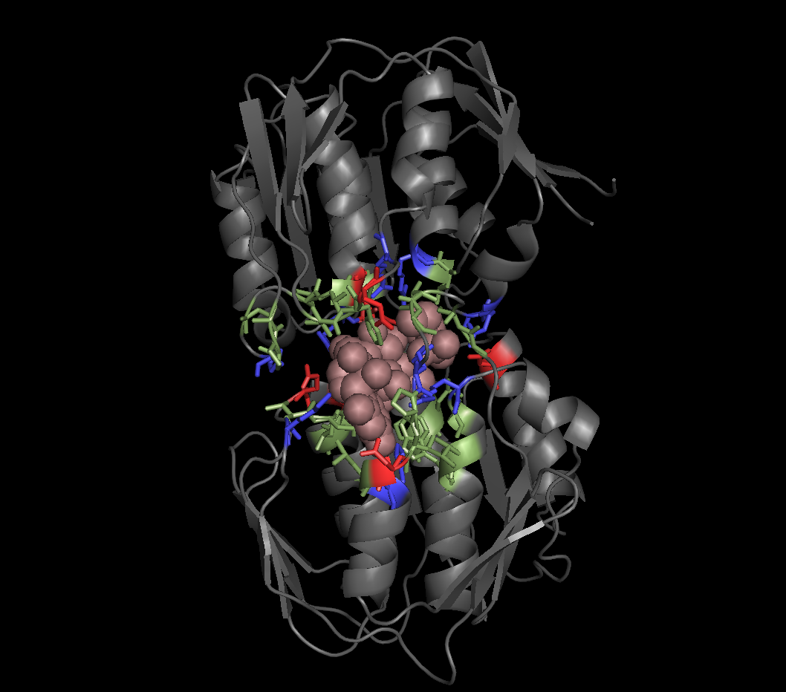
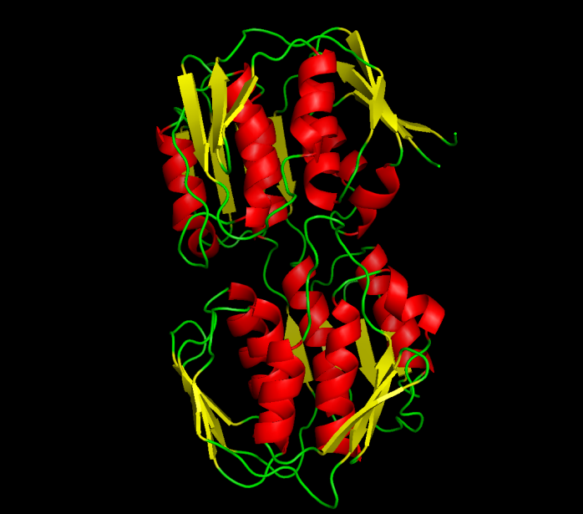
Example:
UDP-N-ACETYLGLUCOSAMINE ENOLPYRUVYL TRANSFERASE (PDB:1UAE)
Functional Pocket Molecular Surface Volume: 1462.40 A³
Density : 19.3 Molar (11.3 M+. 8 M-)
EC2: TRANSFERASES Average Ionizable Density: 19.8 Molar
Crowded
Green: Functional pocket residues
Blue: Basic = Probably Positive = R+K+H
Red: Acid = Probably Negative = E + Q
Brown URIDINE-DIPHOSPHATE-N-
ACETYLGLUCOSAMINE
Jimenez-Morales, Liang, Eisenberg

Slide 15
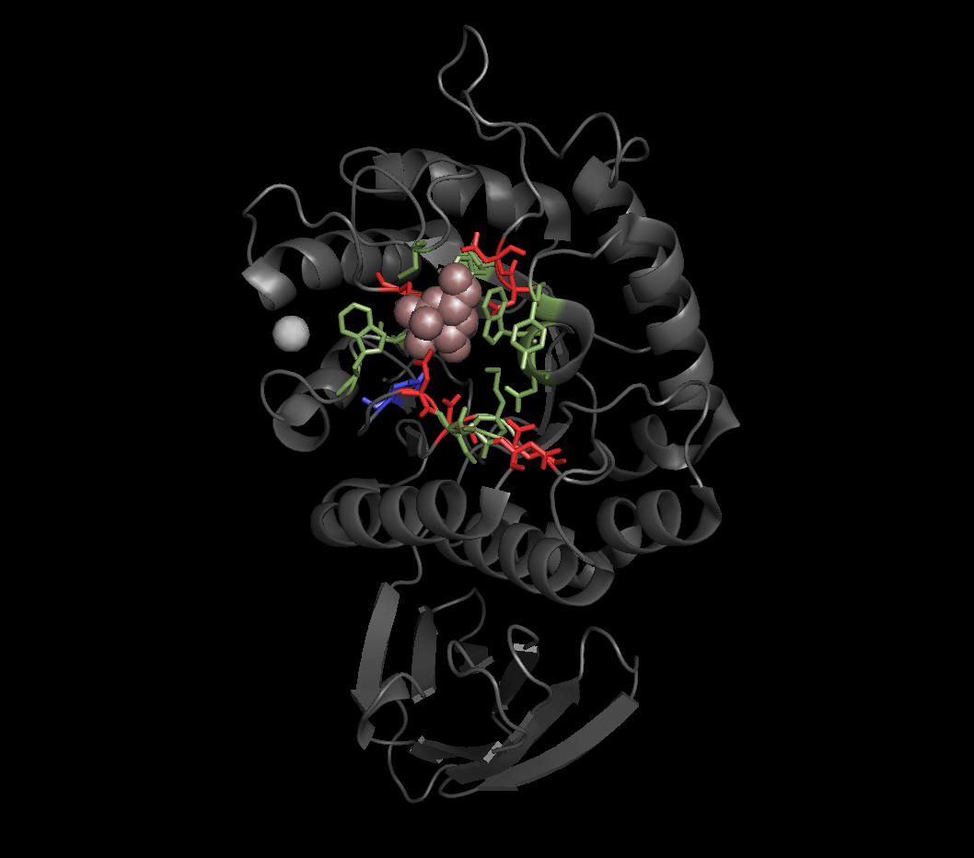
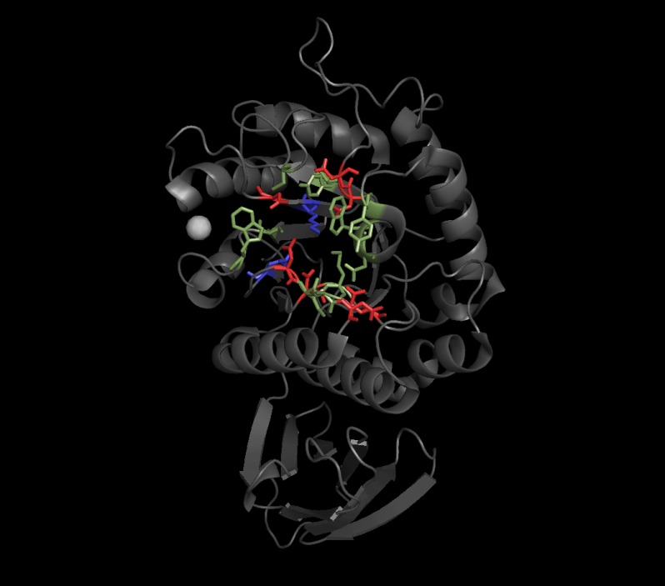
Example:
ALPHA-GALACTOSIDASE (PDB:1UAS)
Functional Pocket Molecular Surface Volume: 286.58 A³
Density : 52.2 Molar (11.6 M+. 40.6 M-)
EC3: HYDROLASES Average Ionizable Density: 26.6 Molar
Crowded
Green: Functional pocket residues
Blue: Basic = Probably Positive = R+K+H
Red: Acid = Probably Negative = E + Q
Brown ALPHA D-GALACTOSE
Jimenez-Morales, Liang, Eisenberg

Slide 16
Ions in Water are the Liquid of Life
They are not ideal solutions
Everything Interacts
with Everything
For Modelers and Mathematicians
Tremendous Opportunity for Applied Mathematics Chun Liu’s Energetic Variational Principle
EnVarA

Slide 17
Working Hypothesis
Biological Adaptation is
Crowded Ions and Side Chains
Everything interacts
‘law’ of mass action assumes nothing interacts

Slide 18
Work of Dirk Gillespie and Gerhard Meissner, not Bob Eisenberg
RyR Channel:
Current Voltage Curves

Slide 19
Best Evidence is from the
RyR Receptor
Gillespie, Meissner, Le Xu, et al, not Bob Eisenberg
More than 120 combinations of solutions & mutants
7 mutants with significant effects fit successfully

Slide 20
Selected PNP-DFT Publications
Dirk Gillespie
January 2012
Gillespie, D., W. Nonner and R. S. Eisenberg (2002). "Coupling Poisson-Nernst-Planck and Density Functional Theory to Calculate Ion Flux." Journal of Physics (Condensed Matter) 14: 12129-12145.
Gillespie, D., W. Nonner and R. S. Eisenberg (2003). "Density functional theory of charged, hard-sphere fluids." Physical Review E 68: 0313503.
Gillespie, D., M. Valisko,D. Boda (2005). "Density functional theory of the electrical double layer: the RFD functional." J of Physics: Condensed Matter 17: 6609-6626.
Roth, R. and D. Gillespie (2005). "Physics of Size Selectivity." Physical Review Letters 95: 247801.
Gillespie, D. and D. Boda (2008). "The Anomalous Mole Fraction Effect in Calcium Channels: A Measure of Preferential Selectivity." Biophys. J. 95(6): 2658-2672.
Gillespie, D., D. Boda, Y. He, P. Apel and Z. S. Siwy (2008). "Synthetic Nanopores as a Test Case for Ion Channel Theories: The Anomalous Mole Fraction Effect without Single Filing." Biophys. J. 95(2): 609-619.
Gillespie, D. and M. Fill (2008). "Intracellular Calcium Release Channels Mediate Their Own Countercurrent: The Ryanodine Receptor Case Study." Biophys. J. 95(8): 3706-3714.
Malasics, A., D. Gillespie and D. Boda (2008). "Simulating prescribed particle densities in the grand canonical ensemble using iterative algorithms." Journal of Chemical Physics 128: 124102. Roth, R., D. Gillespie, W. Nonner and B. Eisenberg (2008). "Bubbles, Gating, and Anesthetics in Ion Channels." Biophys. J. 94 4282-4298.
19) Bardhan, J. P., R. S. Eisenberg and D. Gillespie (2009). "Discretization of the induced-charge boundary integral equation." Physical Review E (Statistical, Nonlinear, and Soft Matter Physics) 80(1): 011906-10.
Boda, D., M. Valisko, D. Henderson, B. Eisenberg, D. Gillespie and W. Nonner (2009). "Ionic selectivity in L-type calcium channels by electrostatics and hard-core repulsion." J. Gen. Physiol. 133(5): 497-509.
Gillespie, D., J. Giri and M. Fill (2009). "Reinterpreting the Anomalous Mole Fraction Effect. The ryanodine receptor case study." Biophyiscal Jl 97(8): pp. 2212 - 2221
He, Y., D. Gillespie, D. Boda, I. Vlassiouk, R. S. Eisenberg and Z. S. Siwy (2009). "Tuning Transport Properties of Nanofluidic Devices with Local Charge Inversion." Journal of the American Chemical Society 131(14): 5194-5202.
Gillespie, D. (2010). "Analytic Theory for Dilute Colloids in a Charged Slit." The Journal of Physical Chemistry B 114(12): 4302-4309.
Boda, D., J. Giri, D. Henderson, B. Eisenberg and D. Gillespie (2011). "Analyzing the components of the free-energy landscape in a calcium selective ion channel by Widom's particle insertion method." J Chem Phys 134(5): 055102-14.
Gillespie, D. (2011). "Toward making the mean spherical approximation of primitive model electrolytes analytic: An analytic approximation of the MSA screening parameter." J Chem Phys 134(4): 044103-3.
Gillespie, D. (2011). "Free-Energy Density Functional of Ions at a Dielectric Interface." The Journal of Physical Chemistry Letters: 1178-1182.
Krauss, D., B. Eisenberg and D. Gillespie (2011). "Selectivity sequences in a model calcium channel: role of electrostatic field strength." European Biophysics Journal 40(6): 775-782.
Krauss, D. and D. Gillespie (2010). "Sieving experiments and pore diameter: it’s not a simple relationship." European Biophysics Journal 39: 1513-1521.

Slide 21
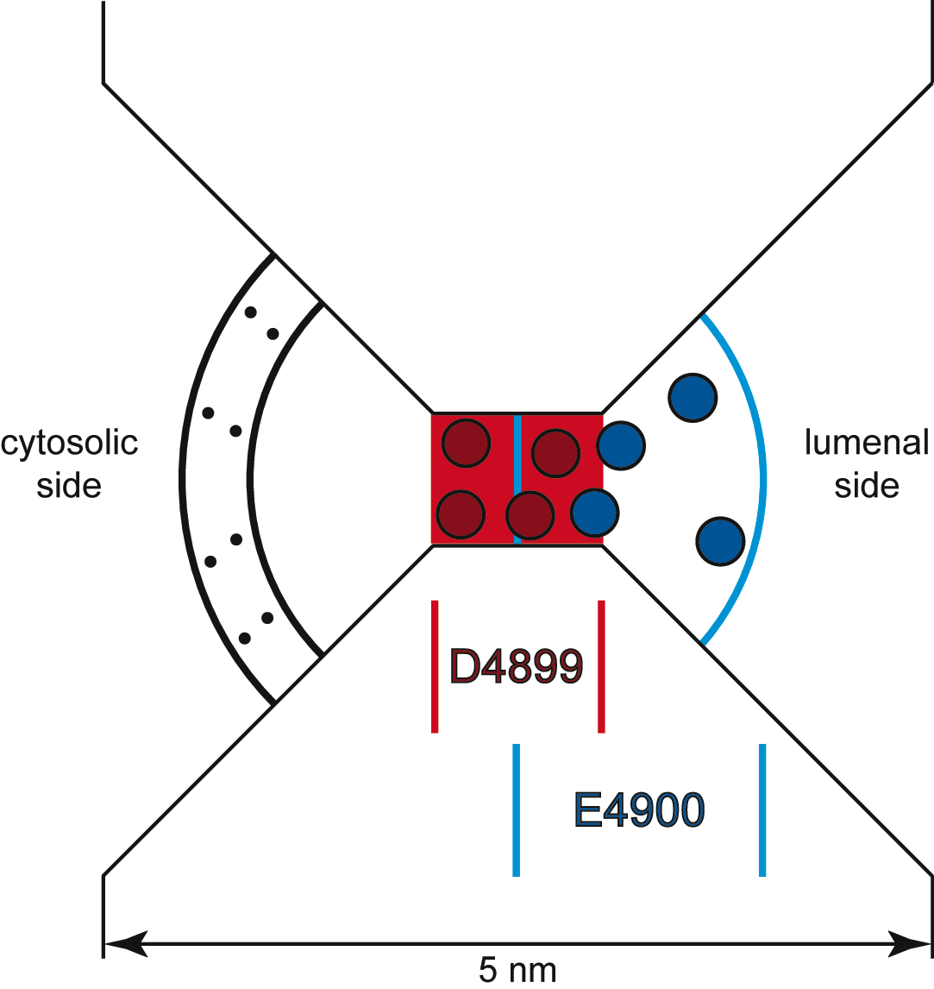
The Geometry
Selectivity Filter
is 10 Å long and 8 Å in diameter
confines four D4899 negative amino acids.
Four E4900 positive amino acids are on lumenal side, overlapping D4899.
Cytosolic distributed charge
Protein
Cytoplasm
Lumen
Protein
D. Gillespie et al., J. Phys. Chem. 109, 15598 (2005).

Slide 22
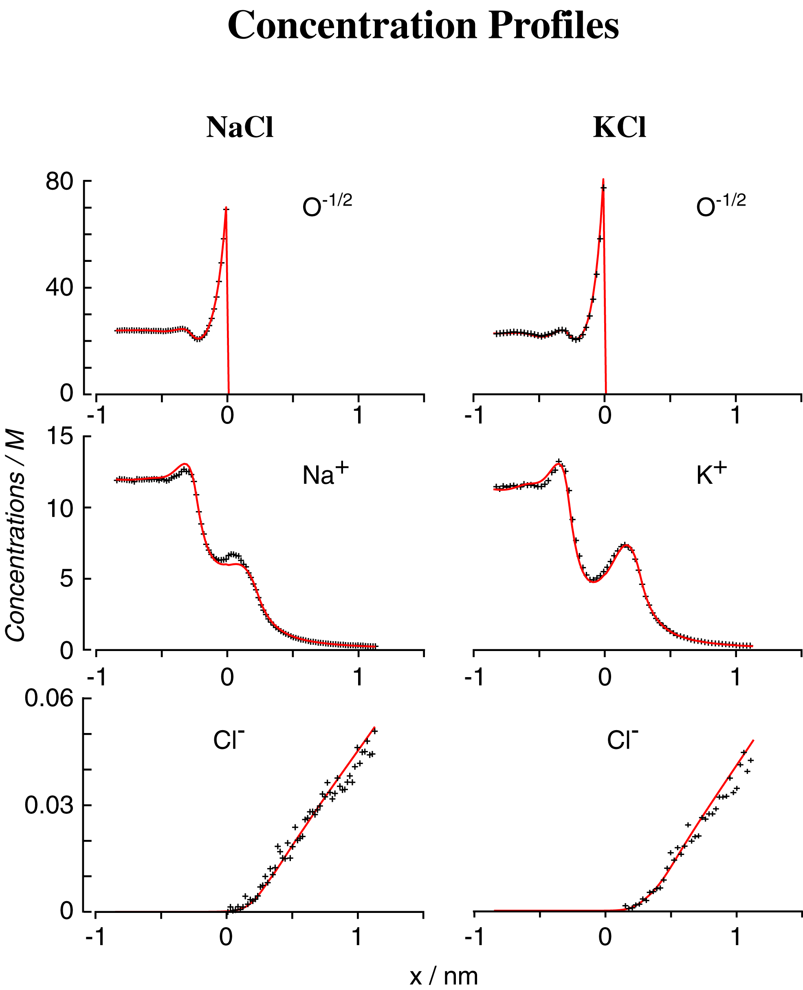
DFT/PNP vs Monte Carlo Simulations
Concentration Profiles
Misfit
Nonner, Gillespie, Eisenberg

Slide 23
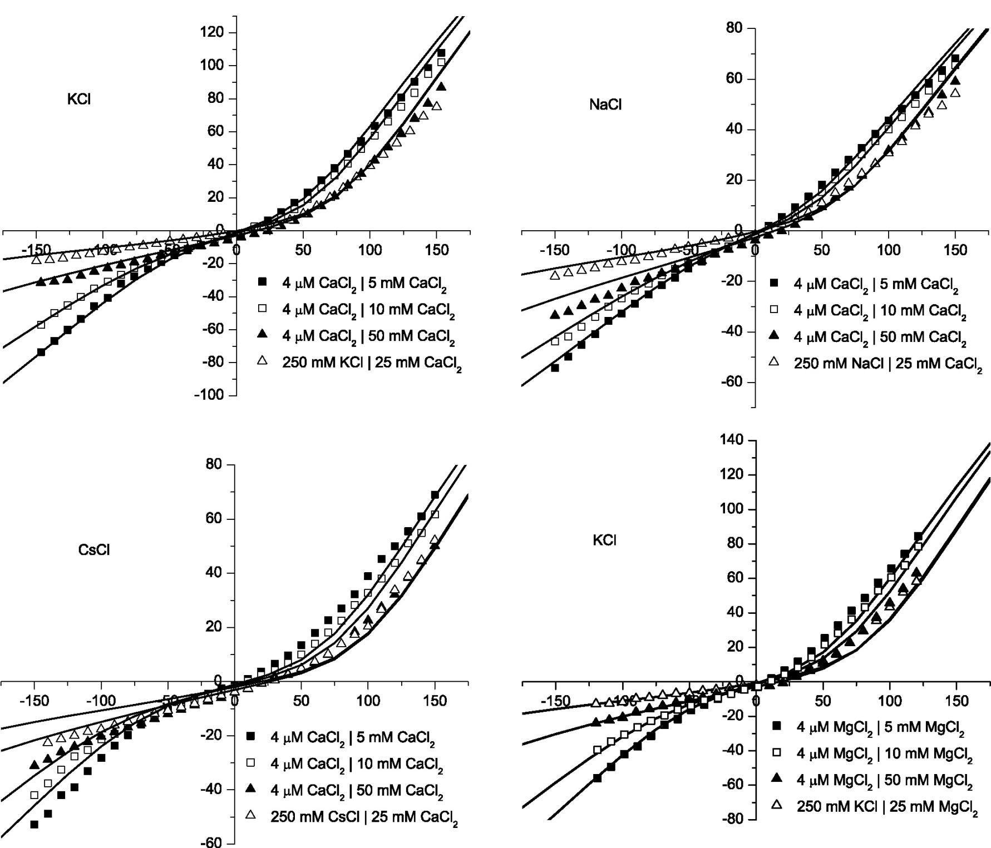
Divalents
Gillespie, Meissner, Le Xu, et al
KCl
CaCl₂
NaCl
CaCl₂
Error < 0.1 kT/e
Misfit
2 kT/e
CsCl
CaCl₂
KCl
MgCl₂
Misfit

Slide 24
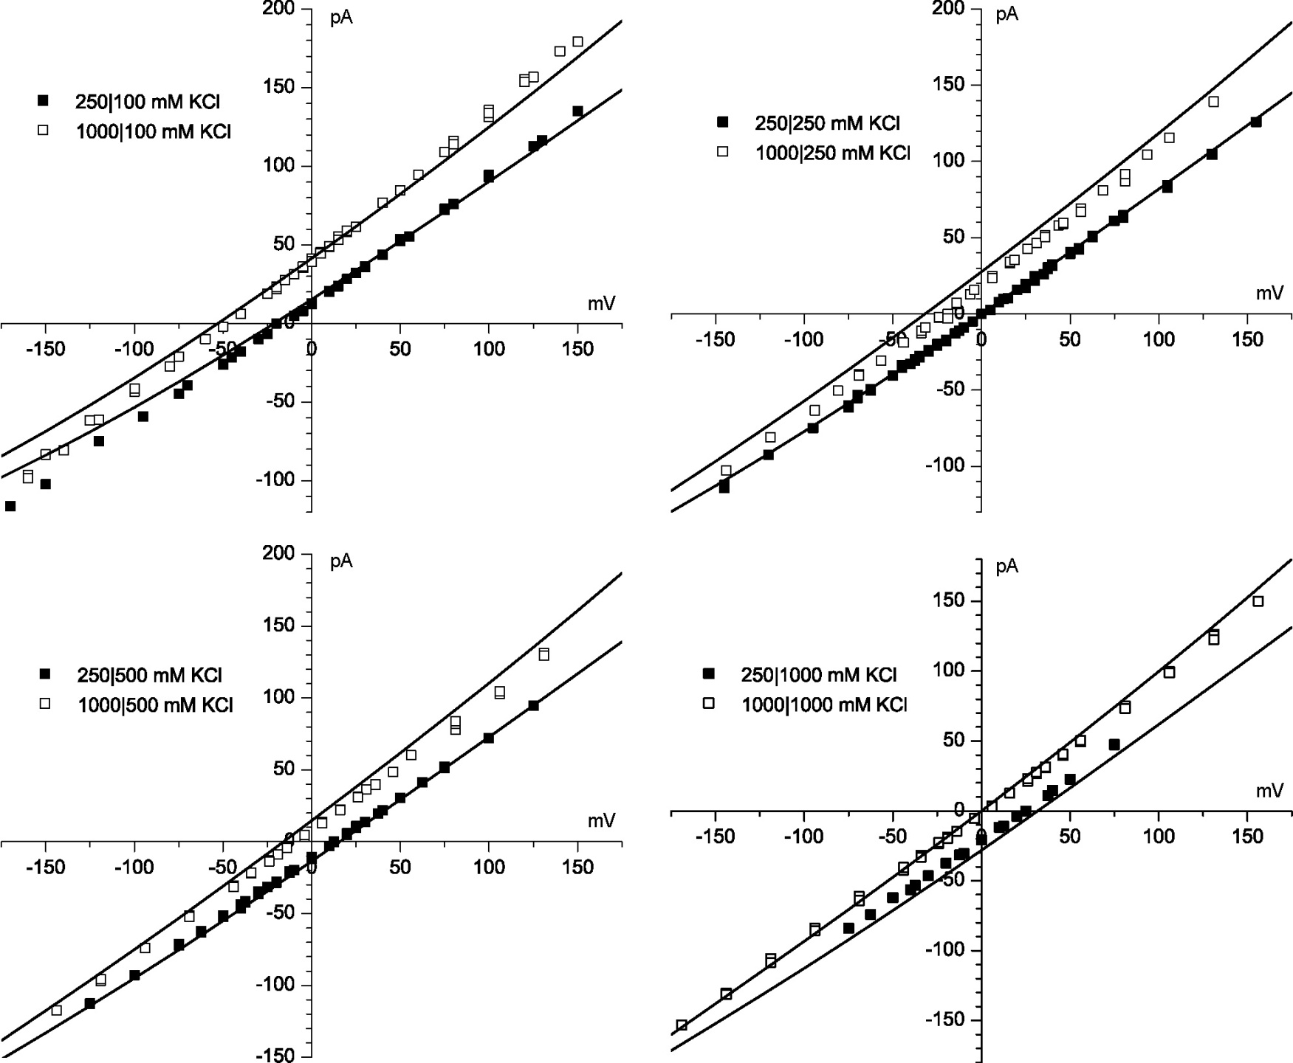
KCl
Gillespie, Meissner, Le Xu, et al
4 kT/e
Error < 0.1 kT/e
Misfit

Slide 25
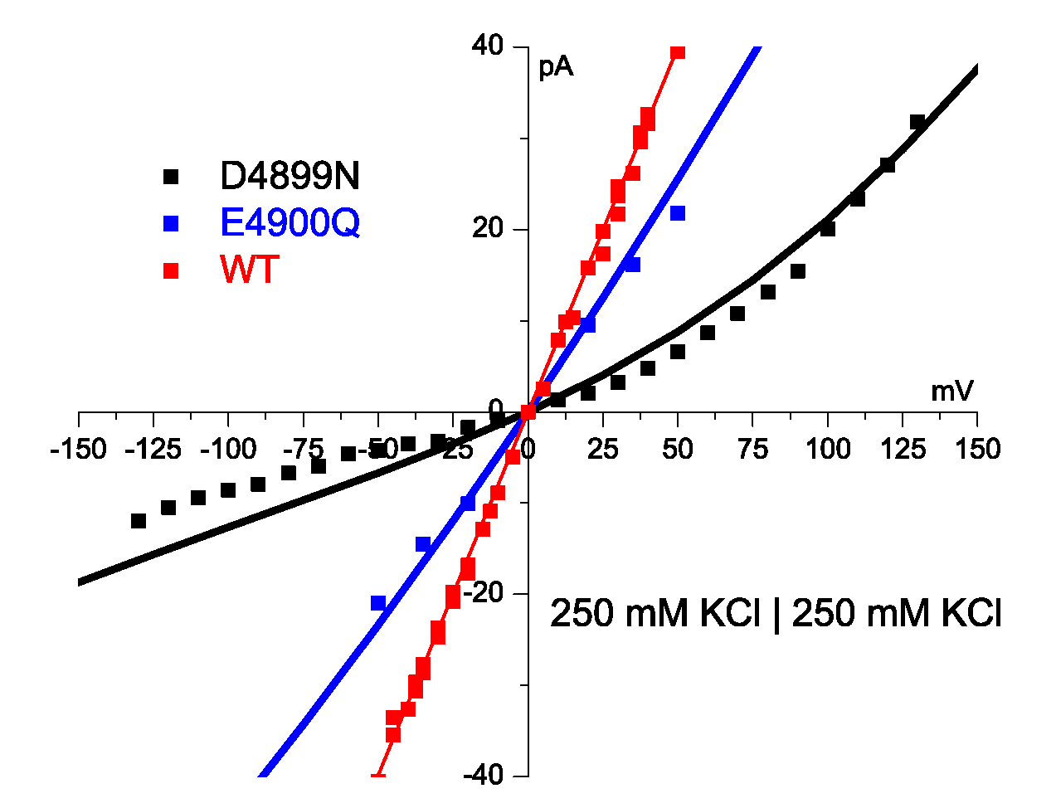
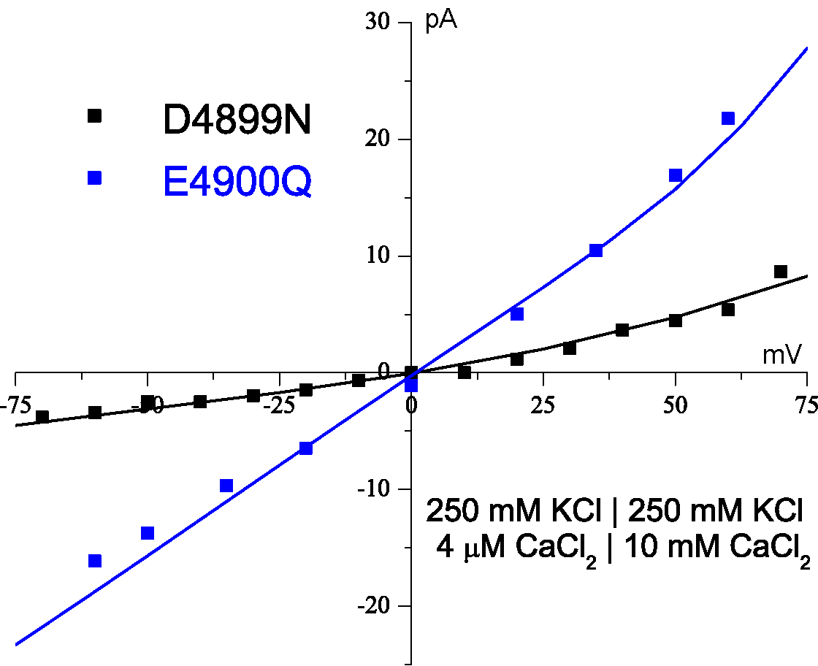
Theory fits Mutation with Zero Charge No parameters adjusted
Theory Fits Mutant in K
Theory Fits Mutant in K + Ca
Error < 0.1 kT/e
1 kT/e
Protein charge density wild type* 13 M
Water is 55 M
*some wild type curves not shown, ‘off the graph’
⇨
0 M in D4899
1 kT/e
Gillespie et al J Phys Chem 109 15598 (2005)

Slide 26
Back to the Calcium Channel
Then, the Sodium Channel

Slide 27
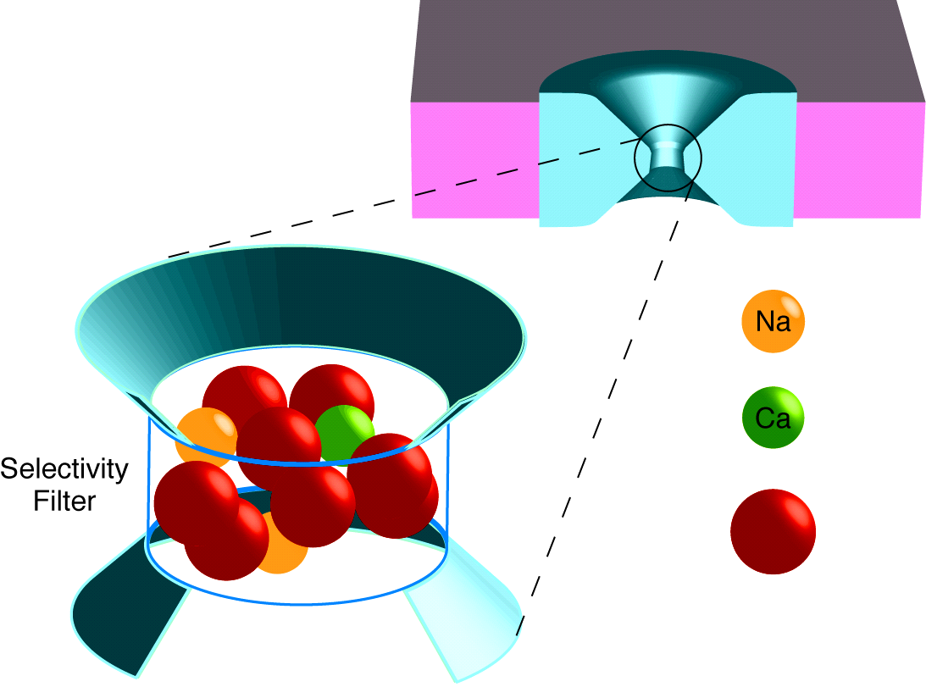
Selectivity Filter Crowded with Charge
L type Ca Channel
+
++
Selectivity Filter
^{“Side Chains”}
O^{−½}
Wolfgang Nonner

Slide 28
large mechanical forces

Slide 29
Multiscale Analysis at Equilibrium
Solved with Metropolis Monte Carlo MMC Simulates Location of Ions both the mean and the variance
Produces Equilibrium Distribution
of location
of Ions and ‘Side Chains’
MMC yields Boltzmann Distribution with correct Energy, Entropy and Free Energy
Other methods give nearly identical results:
Equilibrium Multiscale MSA (mean spherical approximation
SPM (primitive solvent model)
DFT (density functional theory of fluids),
Non-equilibrium Multiscale
DFT-PNP (Poisson Nernst Planck)
EnVarA…. (Energy Variational Approach)
δ-PNP (in progress) etc

Slide 30
Metropolis Monte Carlo Simulates Location of Ions both the mean and the variance
Details:
Start with Configuration A, with computed energy E_{A}
Move an ion to location B, with computed energy E_{B}
If spheres overlap, E_{B} → ∞ and configuration is rejected
If spheres do not overlap, E_{B} → 0 and configuration is accepted
If E_{B} < E_{A} : accept new configuration.
If E_{B} > E_{A} : accept new configuration with probability
Key idea
MMC chooses configurations with a Boltzmann probability and weights them evenly instead of choosing them from uniform distribution and then weighting them with exp(−E/k _{B}T)

Slide 31
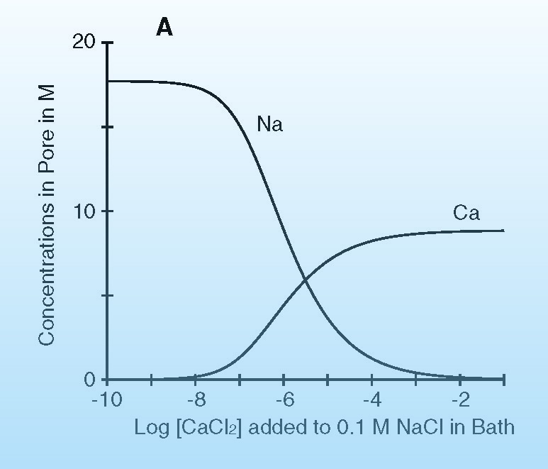
Selective Binding Curve L type Ca channel
Wolfgang Nonner

Slide 32
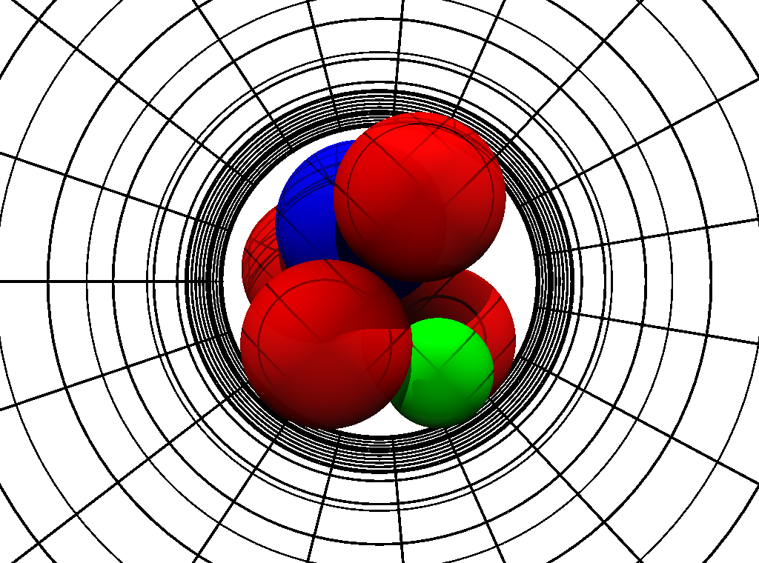
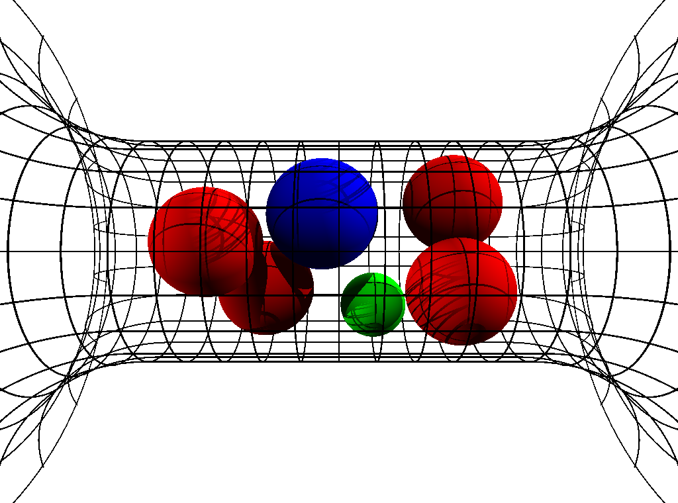
Crowded Ions
Radial Crowding is Severe
Ion Diameters ‘Pauling’ Diameters
Ca⁺⁺ | 1.98 Å
Na⁺ | 2.00 Å
K⁺ | 2.66 Å
‘Side Chain’ Diameter
Lysine K | 3.00 Å
D or E | 2.80 Å
Channel Diameter 6 Å
6Å
Snap Shots of Contents
Parameters are Fixed in all calculations in all solutions for all mutants
‘Side Chains’ are Spheres Free to move inside channel
Experiments and Calculations done at pH 8
Boda, Nonner, Valisko, Henderson, Eisenberg & Gillespie

Slide 33
Mutation
Na Channel
Ca Channel
Same Parameters
E
E
E
A
D
E
K
A
Charge -3e
Charge -1e
1
0.004
Na⁺
Ca²⁺
Na⁺
Occupancy (number)
0.002
0.5
Ca²⁺
0
0
-6
-4
-2
0
0.05
0.1
log (Concentration/M)
Concentration/M
EEEE has full biological selectivity ^{in similar simulations}
Boda, et al

Slide 34
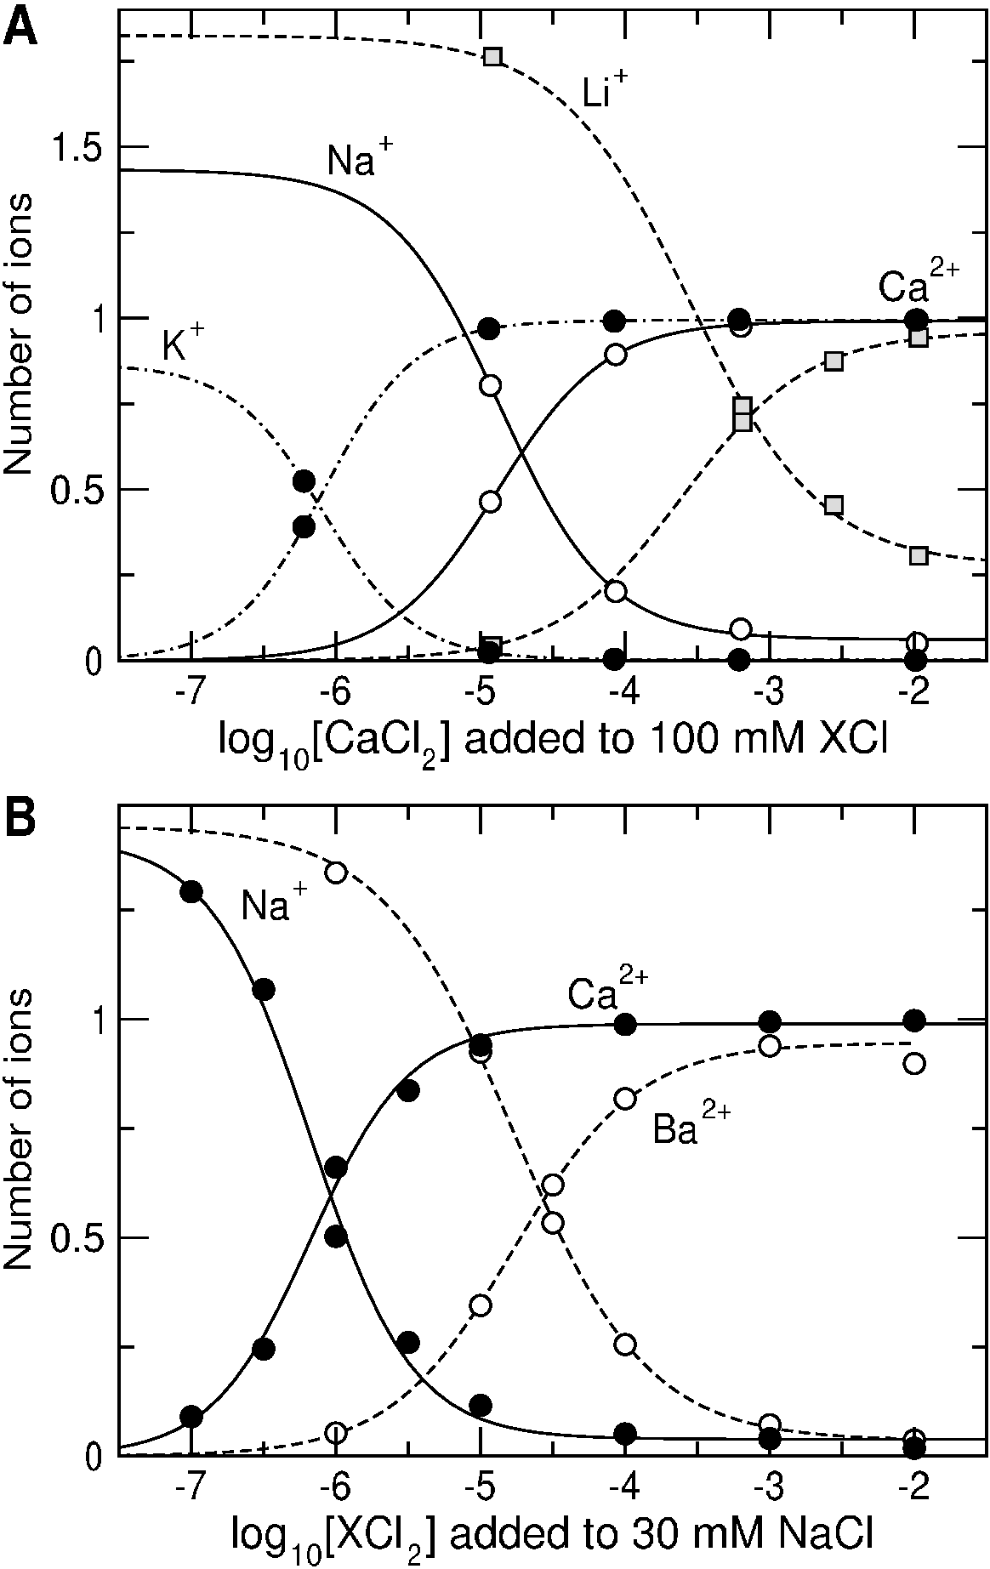
Na, K, Li, Ca, Ba Binding in Calcium Channel

Slide 35
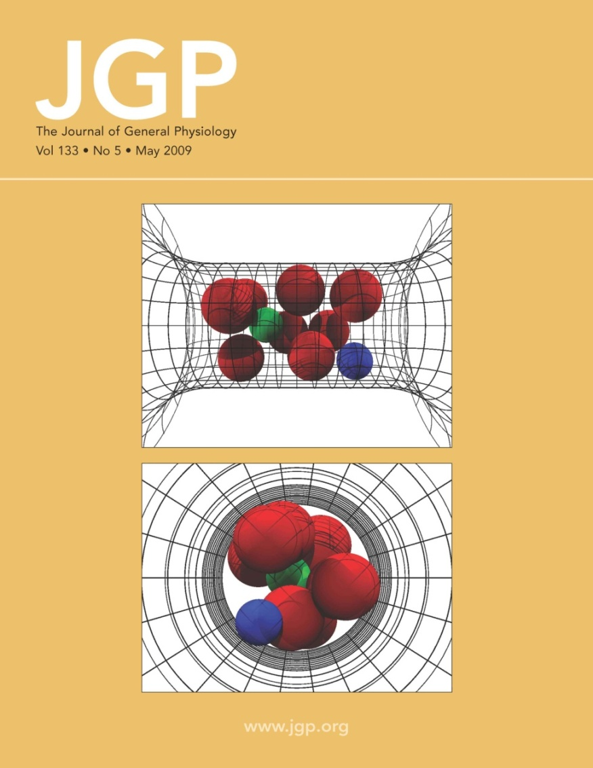
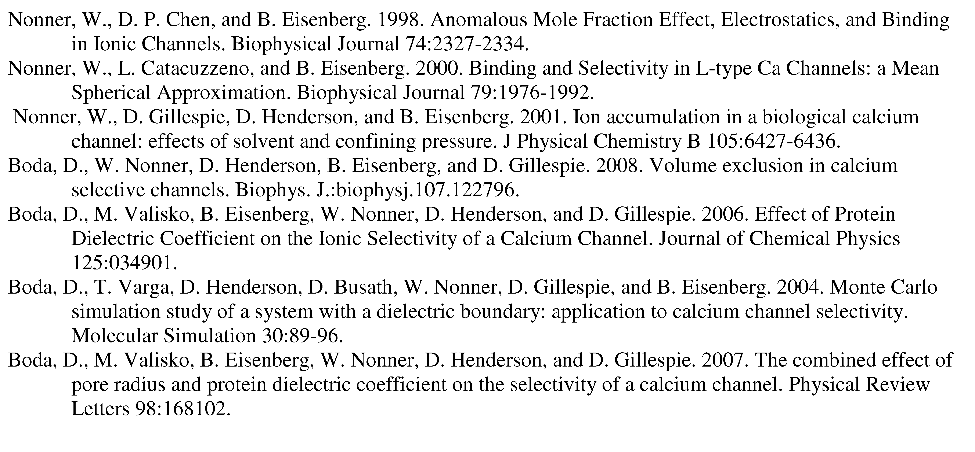
Calcium Channel has been examined in ~35 papers, e.g.,
Most of the papers are available at
ftp://ftp.rush.edu/users/molebio/Bob_Eisenberg/Reprints
http://www.phys.rush.edu/RSEisenberg/physioeis.html

Slide 36
Selectivity comes from Electrostatic Interaction and Steric Competition for Space
Repulsion
Location and Strength of Binding Sites Depend on Ionic Concentration and Temperature, etc Rate Constants are Variables

Slide 37
Challenge
from leading biophysicists
Walter Stühmer and Stefan Heinemann
Max Planck Institutes, Göttingen, Leipzig
Can a physical theory explain the mutation Calcium Channel into Sodium Channel?
DEEA DEKA
Calcium Channel Side chains of protein
Sodium Channel Side chains of protein

Slide 38
DEKA Sodium Channel has very different properties from Ca channel, e.g., ‘binding’ curve, Na⁺ vs Ca⁺⁺ selectivity Na⁺ vs K⁺ selectivity

Slide 39
DEKA Sodium Channel 6 Å
Sodium Channel
specifically, the
Aspartate D Acid Negative
Glutamate E Acid Negative
Lysine K Basic Positive
Alanine A Aliphatic Neutral
Nothing to do with potassium ion K⁺
QUALITATIVELY DIFFERENT Properties from the Calcium Channel

Slide 40
Mutation
Na Channel
Ca Channel
Same Parameters
E
E
E
A
D
E
K
A
Charge -3e
Charge -1e
1
0.004
Na⁺
Ca²⁺
Mutation
Na⁺
Occupancy (number)
0.002
0.5
Same Parameters
Ca²⁺
0
0
-6
-4
-2
0
0.05
0.1
log (Concentration/M)
Concentration/M
EEEE has full biological selectivity ^{in similar simulations}
Boda, et al

Slide 41
Nothing was changed from the EEEA Ca channel except the amino acids
Calculated DEKA Na Channel Selects Ca ²⁺ vs. Na ⁺ and also K⁺ vs. Na⁺
Calculations and experiments done at pH 8

Slide 42
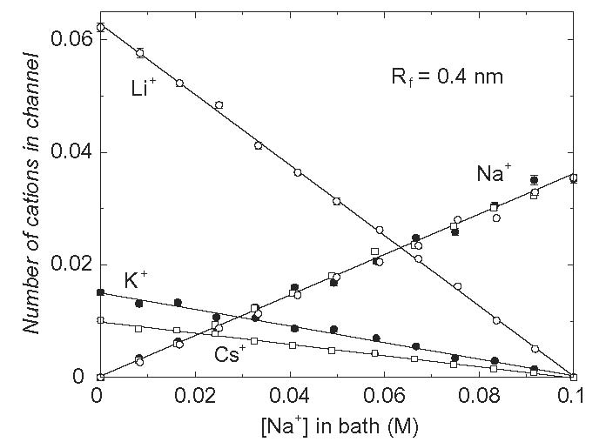
Na, K, Li, Cs Binding in Sodium channel

Slide 43
How? Usually Complex Answers* How does DEKA Na Channel Select Na⁺ vs. K⁺ ? * Gillespie, D., Energetics of divalent selectivity in the ryanodine receptor. Biophys J (2008). 94: p. 1169-1184 * Boda, et al, Analyzing free-energy by Widom's particle insertion method. J Chem Phys (2011) 134: p. 055102-14
Calculations and experiments done at pH 8

Slide 44


Size Selectivity is in the Depletion Zone
Na⁺ vs. K⁺ Occupancy
Binding Sites NOT SELECTIVE
Channel Protein
Na⁺
[NaCl] = 50 mM [KCl] = 50 mM pH 8
K⁺
Concentration [Molar]
Selectivity Filter
K⁺
Na⁺
Na Selectivity because 0 K⁺ in Depletion Zone
Depletion Zone
of the DEKA Na Channel, 6 Å
Boda, et al

Slide 45
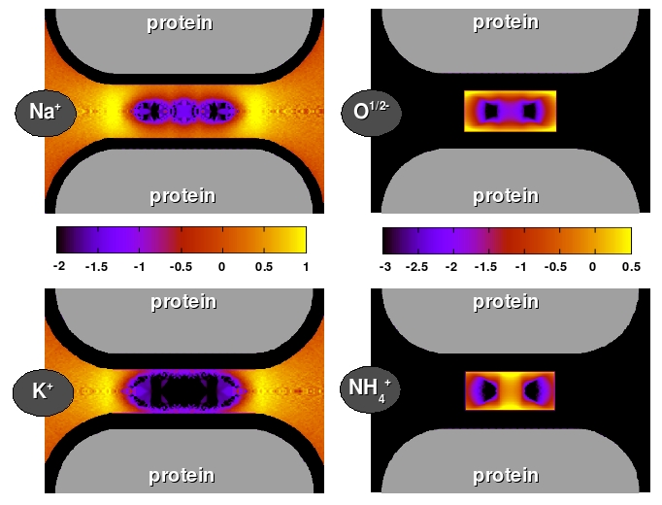
Binding Sites
Size Selectivity
*Binding Sites are outputs of our INDUCED FIT Model of Selectivity, not structural inputs
NOT selective
Selectivity Filter
Selectivity Filter
[NaCl] = [KCl] = 50 mM
Ion Diameter
Ca⁺⁺ | 1.98 Å
Na⁺ | 2.00 Å
K⁺ | 2.66 Å
‘Side Chain’ Diameter
 | 3.00 Å pH 8
 | 2.80 Å pH 8
Na Channel DEKA 6 Å
Selectivity Filter
Selectivity Filter
log C/C_{ref}
Selectivity Filter
Selectivity Filter
Lys or K
Selectivity Filter
Selectivity Filter
D or E
Na vs K Size Selectivity is in Depletion Zone
Boda, et al
BLACK = Depletion=0

Slide 46
Structure is the Computed Consequence of Forces in these models
Selectivity Depends on Structure

Slide 47
What do the Variables do? What happens if we Vary structure (Diameter)? and Vary Dehydration/Re-solvation? Dielectric coefficient is Dehydration/Re-solvation
Sensitivity Analysis

Slide 48
Inverse Problem We discover Orthogonal§ Control Variables* in simulations of the Na channel, but not the Ca channel. *These emerge as outputs, not inputs.
Selectivity depends only on Structure
Conductance depends only on Contents, i.e., dehydration; i.e., dielectric)
Selectivity depends not on Contents, i.e., dehydration; i.e., dielectric) Conductance depends not on Structure
*Orthogonal:

Slide 49
Control Variables Selectivity Na⁺ vs K⁺
Selectivity Depends on Structure
Depends STEEPLY on channel diameter
Depends only on channel diameter

Slide 50
Structure is the Computed Consequence of Forces in these models
Selectivity Depends on Structure

Slide 51
Control Variables Conductance of DEKA Na⁺ channel
Amazingly simple, not complex
Selectivity Depends Steeply on Diameter
Selectivity depends only on diameter
Contents
and Selectivity
Control Variables are
Orthogonal*
Amazingly,
Selectivity depends only on Structure
Conductance depends only on Contents, i.e., dehydration; i.e., dielectric)
Selectivity depends not on Contents, i.e., dehydration; i.e., dielectric) Conductance depends not on Structure
*Orthogonal:
Boda, et al

Slide 52
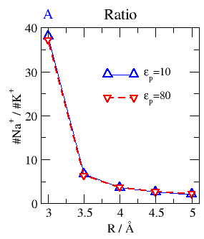
Na⁺ vs K⁺ (size) Selectivity (ratio) Depends on Channel Size, not Dehydration (Protein Dielectric Coefficient)*
Selectivity
for small ion
Na⁺
2.00 Å
K⁺
Na⁺
K⁺
2.66 Å
6 8 10
Small Channel Diameter Large in Å
Boda, et al
*in DEKA Na Channel

Slide 53
Control Variables Conductance of DEKA Na⁺ channel
Conductance Depends Steeply on Dehydration/Re-solvation (i.e., dielectric)
Contents depend only on dehydration/re-solvation (dielectric)
but
Selectivity does not depend on Dielectric
Selectivity depends only on Structure

Slide 54
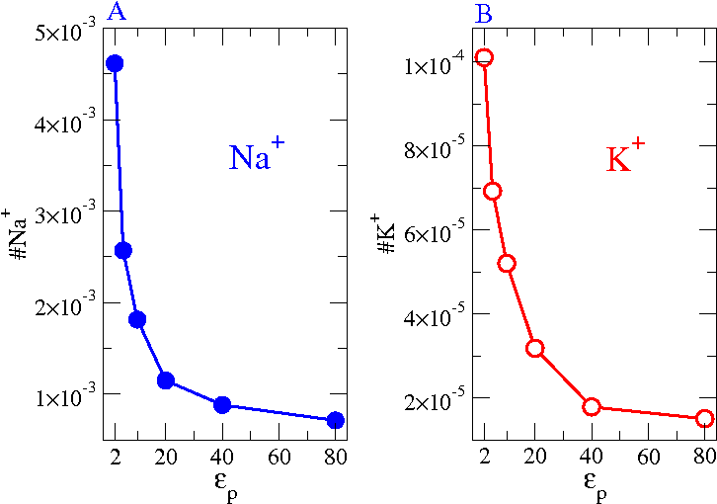
Control Variable Channel Contents (occupancy) depends on Protein Polarization (re-solvation)
DEKA Na Channel, 6 Å
Na⁺
Occupancy
2.0 Å
K⁺
2.66 Å
Channel Contents occupancy
Boda, et al

Slide 55
Channel Diameter and Dielectric Coefficient emerge as Orthogonal Control Variables* in simulations of the Na channel, but not the Ca channel. *These emerge as outputs. They are not inputs.
Static Structure
Dynamic Structure

Slide 56
Structure and Dehydration/Re-solvation emerge as Orthogonal Control Variables* in simulations of the Na channel, but not the Ca channel. *These emerge as outputs. They are not inputs.
Diameter
Dielectric constants

Slide 57
.
Reduced Models are Needed
Reduced Models are Device Equations
like Input Output Relations of Engineering Systems.
The device equation is the mathematical
statement of how the system works.
Device Equations describe ‘Slow Variables’
found in some complicated systems

Slide 58
Chemically Specific Properties
of ions (e.g. activity = free energy per mole) are known to come from interactions of their Diameter and Charge
and dielectric ‘constant’ of ionic solution
Atomic Detail
‘Primitive Implicit Solvent Model’ learned from Doug Henderson, J.-P. Hansen, Stuart Rice, Monte Pettitt among others … Thanks!

Slide 59
.
Finding the reduced model,
checking its validity,
estimating its parameters, and their effects, are all part of the
Inverse Problem
‘Reverse Engineering’ of Selectivity

Slide 60
Biology is Easier than Physics
Reduced Models Exist*
for important biological functions
or the
Animal would not survive
to reproduce
*Evolution provides the existence theorems and uniqueness conditions so hard to find in theory of inverse problems

Slide 61
Biology is Easier than Physics
Biology Says a Simple Model Exists
Existence of Life
Implies Existence of a Simple Model

Slide 62
Existence of Life
implies the
Existence of Robust Multiscale Models
Biology Says there is a Simple Model of Specificity
and other vital functions

Slide 63
Reduced models are the adaptation created by evolution to perform the biological function of selectivity
Inverse Methods are needed to
Establish the Reduced Model
and its Parameters

Slide 64
Inverse Problems
Badly posed, simultaneously over and under determined.
Exact choice of question and data are crucial
Underlying Math Problem (with DFT, noise and systematic error) has actually been solved
using Tikhonov Regularization as in the Inverse Problem of a Blast Furnace Burger, Eisenberg and Engl (2007) SIAM J Applied Math 67: 960-989

Slide 65
Modelers and Mathematicians, Bioengineers: this is reverse engineering
Inverse Problems Many answers are possible Central Issue
Which answer is right?
Underlying Math Problem (with DFT, noise and systematic error) has actually been solved
using Tikhonov Regularization as in the Inverse Problem of a Blast Furnace Burger, Eisenberg and Engl (2007) SIAM J Applied Math 67: 960-989

Slide 66
How does the Channel control Selectivity?
Inverse Problems: many answers possible
Central Issue
Which answer is right?
Key is
ALWAYS
Large Amount of Data
from
Many Different Conditions
Almost too much data was available for Burger, Eisenberg and Engl (2007) SIAM J Applied Math 67: 960-989

Slide 67
Solving Inverse Problems depends on
Fitting Large Amounts of Data
from many Different Techniques

Slide 68
Dealing with Different Experimental Traditions is an unsolved social problem
What was measured?
With what setup?
With what assumptions?

Slide 69
Ion Channels are a good test case
because I know the experimental tradition
Channels are also Biologically Very Important
Help! Do not yet have collaboration with someone who knows the EXPERIMENTAL literature of Electrolyte Solutions.

Slide 70
Miracle
We can actually compute the Channel Contents & Structure that determine Selectivity

Slide 71
New Miracle??
Can EnVarA actually compute the Function of these systems?

Slide 72
The End
Any Questions?

Slide 74
What does the protein do?
Channel and Contents form a Self-Organized Structure
with Side Chains at position of Minimum Free Energy
Protein Fits the Substrate
“Induced Fit Model of Selectivity”

Slide 75
What does the protein do?
(for biologists)
Certain MEASURES of structure are Powerful DETERMINANTS of Function e.g., Volume, Dielectric Coefficient, etc.
Induced Fit Model of Selectivity Atomic Structure is not pre-formed Atomic Structure is an important output of the simulation
Nonner and Eisenberg

Slide 76
What does the protein do?
Protein maintains Mechanical Forces* Volume of Pore Dielectric Coefficient/Boundary Permanent Charge
* Driving force for conformation changes ??
Nonner and Eisenberg

Slide 77
Binding Sites* are outputs of our Calculations
Induced Fit Model of Selectivity
Our model has no preformed structural binding sites but Selectivity is very Specific
*Selectivity is in the Depletion Zone, NOT IN THE BINDING SITE of the DEKA Na Channel

Slide 78
Selectivity comes from Electrostatic Interaction and Steric Competition for Space
Repulsion
Location and Strength of Binding Sites Depend on Ionic Concentration and Temperature, etc Rate Constants are Variables

